Slide 1
COMPUTER SECURITY
LECTURE 2
IDENTIFICATION AND AUTHENTICATION
M M Waseem Iqbal
Waseem.iqbal@mcs.edu.pk

Slide 2
REVIEW
Classify each of the following as a violation of confidentiality, of integrity, of availability, or of some combination thereof.
  John copies Mary's homework.
  Paul crashes Linda's system.
  Carol changes the amount of Angelo's check from $100 to $1,000.
  Gina forges Roger's signature on a deed.
  Rhonda registers the domain name "AddisonWesley.com" and refuses to let the publishing house buy or use that domain name.
  Jonah obtains Peter's credit card number and has the credit card company cancel the card and replace it with another card bearing a different account number.
  Henry spoofs Julie's IP address to gain access to her computer.

Slide 3
REVIEW
Identify mechanisms for implementing the following. State what policy or policies they might be enforcing.
  A password changing program will reject passwords that are less than five characters long or that are found in the dictionary.
  Only students in a computer science class will be given accounts on the department's computer system.
  The login program will disallow logins of any students who enter their passwords incorrectly three times.
  The permissions of the file containing Carol's homework will prevent Robert from cheating and copying it.
  When World Wide Web traffic climbs to more than 80% of the network's capacity, systems will disallow any further communications to or from Web servers.
  Annie, a systems analyst, will be able to detect a student using a program to scan her system for vulnerabilities.
  A program used to submit homework will turn itself off just after the due date.

Slide 4
USER IDENTIFICATION & AUTHENTICATION
Is he/she a registered user at the system? (user identification)
Can he/she prove who he/she is? (user authentication)

Slide 5
USERNAME AND PASSWORD
Username: identification purpose
Password: authentication purpose
The mostly used approach to identification and authentication.

Slide 6
PROBLEMS WITH PASSWORDS
Password guessing by attacker
Password spoofing
Compromise of system’s password file

Slide 7
GUESSING A PASSWORD
Exhaustive search (Brute Force): try all possible combinations of valid symbols, up to a certain length.
Intelligent search: search through a restricted name space, e.g., names of friends and relatives, car registration number.

Slide 8
DEFENSES BY USER
Set a password
Changing default password: delivered system has a default password.
Password length: prevent exhaustive search
Password format: mix upper and lower case symbols and numerical characters.
Avoid obvious passwords: birth date, etc.

Slide 9
PASSWORD SECURITY BY SYSTEM
Password checkers: The system checks passwords against some dictionary of ‘weak’ passwords.
Password generation: Password generators producing random but pronounceable passwords.
Password aging: In many systems an expiring date can be set, to force a user to change his password.
Limit login attempts: The system can monitor unsuccessful login attempts and react by locking the user account completely or at least for a certain period of time.
Inform user: After a successful login, the system can display the time of the last login and the number of failed attempts since then, to warn the user about recent attempted attacks.

Slide 10
THE PROBLEM
Passwords of complex formats are hard to memorize. If you choose such one, you may have to write it down somewhere and hide it in your office. But this is also dangerous.
Passwords of simple formats are easy to memorize, but do not offer good security.
What if user follows all the security practices but forgets the password?
Question: What do you do in practice?

Slide 11
PASSWORD SPOOFING ATTACKS
Purpose of attack
  Password compromise
Who is the attacker
  Anyone including a legitimate user.
How to attack?
  An attacker runs a program that presents a fake login screen on some terminal or workstation.
  An unsuspecting user comes to this terminal and try to login. The ID and password are then stored. Execution is then handed over to the user, or login is aborted with a (fake) error message and the spoofing program terminates.
  Control is returned to the OS which now prompts the user with a genuine login request. The user tries again, succeeds on this second attempt and remains completely unaware that password has been compromised.

Slide 12
DEFENSE AGAINST PASSWORD SPOOFING ATTACKS
Inform: Displaying the no. of failed logins may indicate to the user that such an attack happened.
Trusted path: Guarantee that user communicates with the operating system and not with a spoofing program. How?
Example: In Windows NT, ALT+CTRL+DEL, invokes the Windows NT operating system login screen. Always use it even you see a login screen!

Slide 13
OTHER CASES: EXAMPLE
Information: Web browsers cache information that make it possible for users to scroll back to pages they have recently visited.
Question: Does this cause any security problem?

Slide 14
EXAMPLE: ONLINE BANKING
You enter your password on a web page, conduct your business, close the banking application, but forget to terminate the browser session.
The next user can scroll back to the page with your password and login as you.

Slide 15
PASSWORD FILE
User Identity Verification: The system compares the password entered by the user against a value stored in the password file.
Claim: The password file must be protected.
How to protect the file?

Slide 16
PROTECTION OF PASSWORD FILE
Cryptographic Protection: Encrypt the password file.
  Question: Does it solve the problem?
  Answer: If the encrypted file is obtained, one may carry out an “offline dictionary attack”.
Protection by operating system: Access control to the file enforced by the operating system.
Better protection: A combination of cryptographic protection and access control, possibly with even further enhancements to slow down dictionary attacks.

Slide 17
PROTECTION OF PASSWORD FILE
Question: How to encrypt a password file?
Answer: One-way functions.
One-way Functions: Given x, it is easy to compute f(x); but it is hard to find x given f(x).
Example: f(x) = a^{x} mod p
Instead of storing password x, we store f(x) in the password file.
When a user logs in and enters a password say x’ the system computes f(x’) and compares it with the stored f(x).

Slide 18
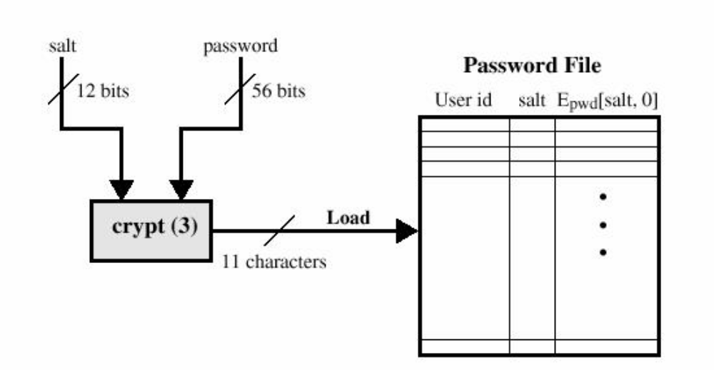
UNIX PASSWORD SCHEME: LOADING A NEW PASSWORD

Slide 19
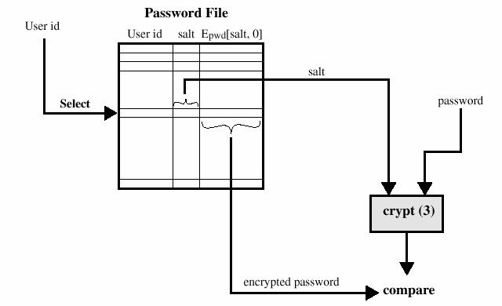
UNIX PASSWORD SCHEME: VERIFYING A PASSWORD FILE

Slide 20
PROTECTION OF PASSWORD FILE
Question: How to protect a password file by access control enforced by an operating system?
Access control mechanisms in an operating system restrict access to files and other resources to users holding the appropriate privileges.
Only privileged users can have write access to the password file.
If read access is restricted to privileged users, then passwords can be stored unencrypted.
If not, store passwords in encrypted form.
Recent versions of Unix store encrypted passwords in a file that is not publicly accessible. Such files are called shadow password files.
E.g. in HP-UX, /.secure/etc/passwd
Windows NT stores encrypted passwords in binary format.
Password salting
  Appending additional information to the password before encryption
  Store the salt with encrypted password.
  Two users having same password will have different entries in the encrypted password file.
  Slows down dictionary attacks

Slide 21
ALTERNATIVE APPROACHES TO USER IDENTIFICATION & AUTHENTICATION
Something you know:
  Example: personal identification number (PIN) used with bank card.
Something you hold:
  Example: a physical key opening a lock.
  Example: A card for accessing the office of the CS Department.
  A physical token can be lost or stolen.
Who you are?
  Biometrics: palm prints, finger prints, iris pattern, retina pattern, voice recognition, signature recognition
What you do?
  Tasks specific to an individual
  Example: Signing on a special pad that measures writing speed and writing pressure.
  Example: Typing speed and intervals between key strokes.
Where you are?
  Example: Login from a specific terminal.
  Mobile and Distributed Computing: Using GPS

Slide 22
OPERATION IN BIOMETRICS AUTHENTICATION
User
Enrollment phase
Initial Measurement
Template
Login Attempt
Remeasure and match

Slide 23
PROBLEMS WITH BIOMETRICS AUTHENTICATION
Initial measure of physical characters: What measure? How to measure?
Authenticated: how good is a match required before a user is considered authenticated?
  Authentication by password gives a clear reject or accept but with biometrics a stored pattern will hardly ever match precisely with the taken measurements.
  Your face picture may vary from time to time due to weight change.
  So the very nature of biometrics requires measuring some property which may vary from time to time, and an algorithm must decide how much variation to allow.

Slide 24
ERROR RATES IN BIOMETRICS AUTHENTICATION
An authentication system can have two kinds of errors:
  false positives: in which an unauthorized user is accepted;
  false negatives: in which an authorized user is rejected.
Find the right balance between these two errors.

Slide 25
REFERENCE
D. Gollmann: Computer Security, Chapter 2: Identification and Authentication

